Slide 1



Idiomatic Programmer Learning Keras
Computer Vision Workshop Version: August 2019

Slide 2
Idiomatic Programmer Learning Keras
Repo: github.com/GoogleCloudPlatform/keras-idiomatic-programmer
Workshops, Handbooks, and Model Zoo

Slide 3
Computer Vision - Data Engineering
Part 6 : Data Collection & Assembly
Part 7 : Data Engineering

Slide 4
Data Collection & Assembly
Data Collection
The capability of a trained model for image classification is dependent on the quantity and distribution of the image data the model was trained with. Here are typical problems you might encounter with your training data:
Too few images overall.
Too few images of a specific label (class).
Insufficient variation in perspective (e.g., angle, zoom).
Insufficient variation in lighting conditions.

Slide 5
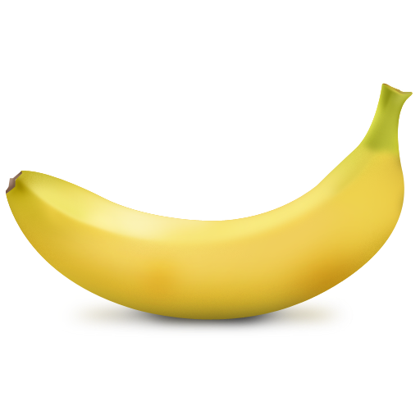
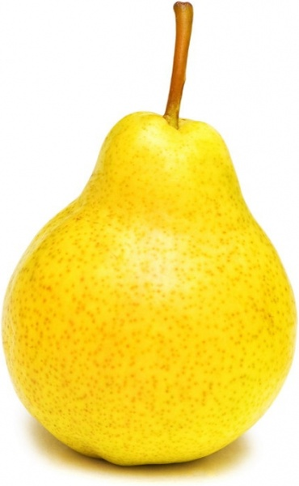
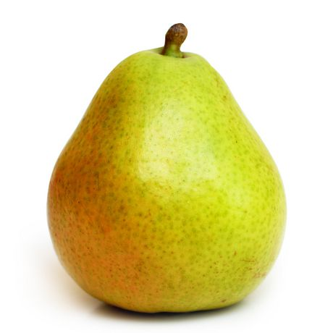
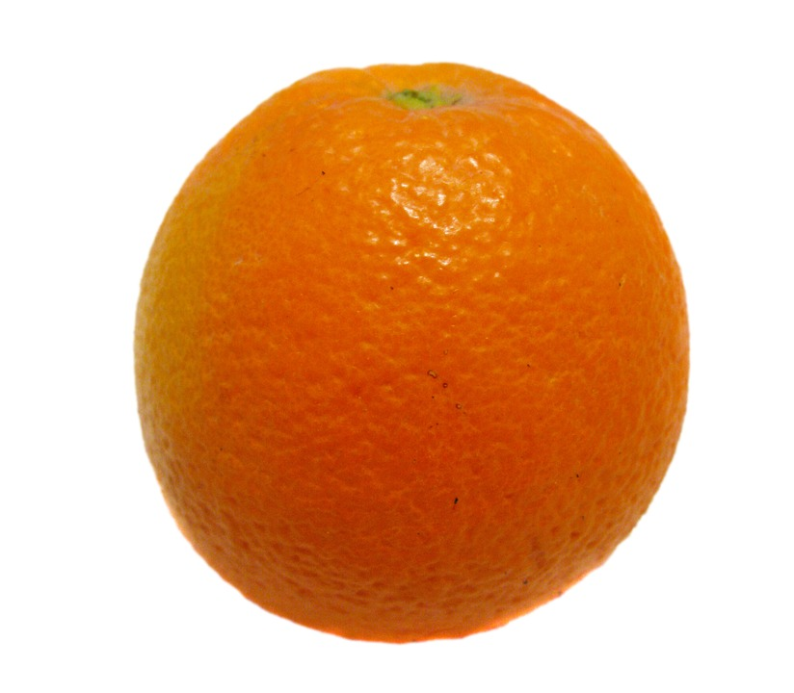
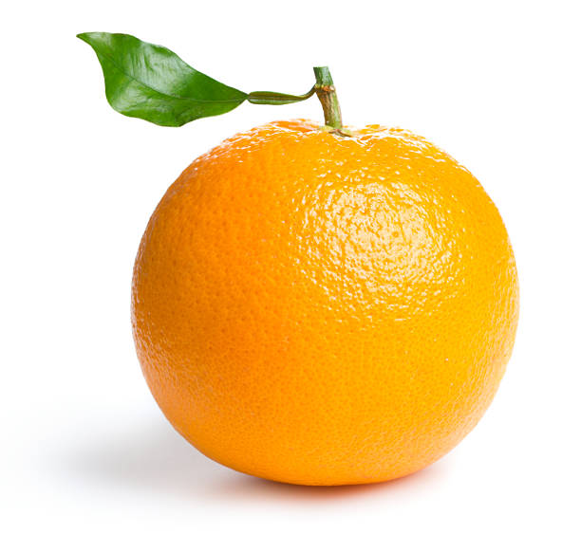
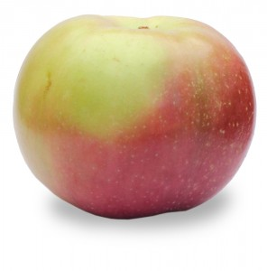
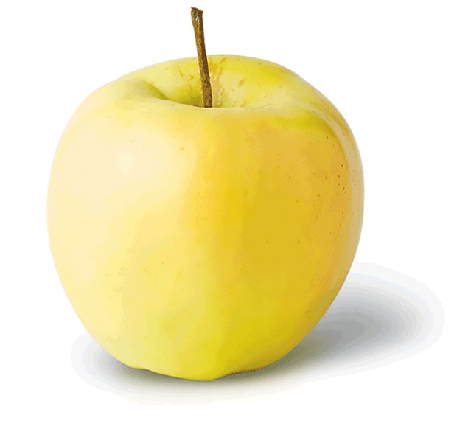
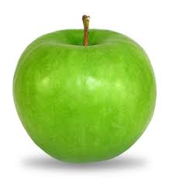
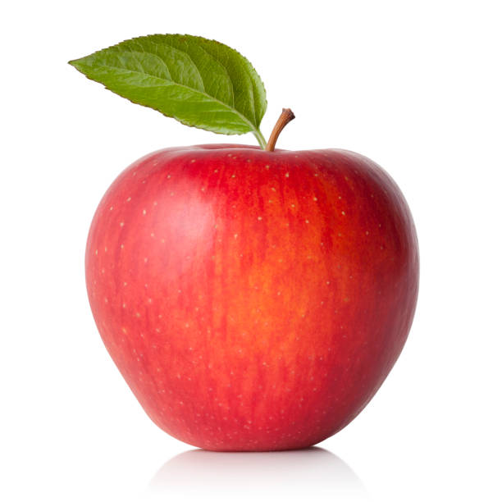
Data Collection - Too Few Images
Too Few Images Overall
A dataset may simply be too small for a convolutional neural network to learn:
The features associated with each label (class).
The distribution of the features across samples of each label.
The variance in the features of each label.
Let’s consider a dataset of types of fruits (e.g., apples, oranges, bananas, pears, etc). Apples, oranges and pears have some similarity in shape, while bananas would be very different in shape. Oranges are fairly consistent in color, while apples and bananas can have a range of colors (green and yellow for both, and red for apples). For apples, pears and oranges, we might still have part of the stem, while bananas have no stems.
Samples of fruits of different colors and with and without stems

Slide 6
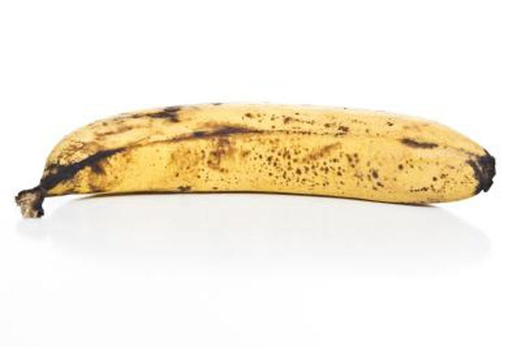
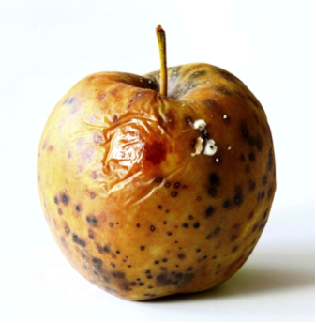
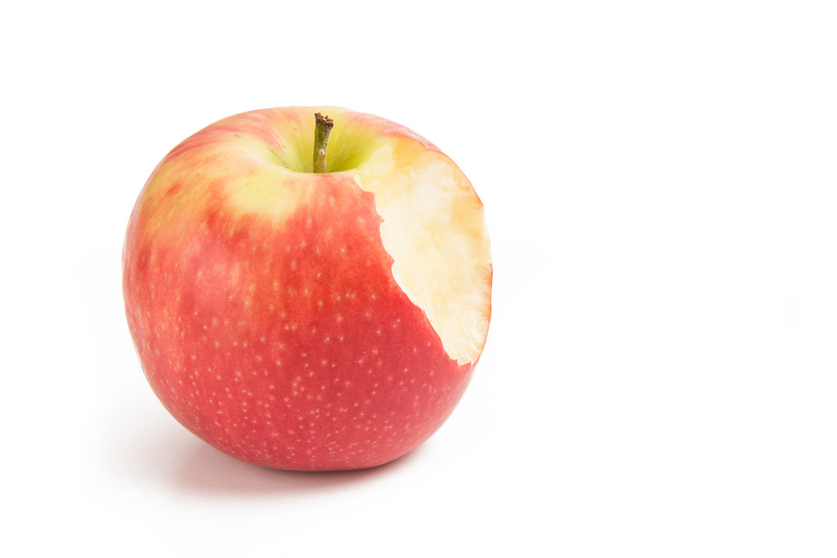
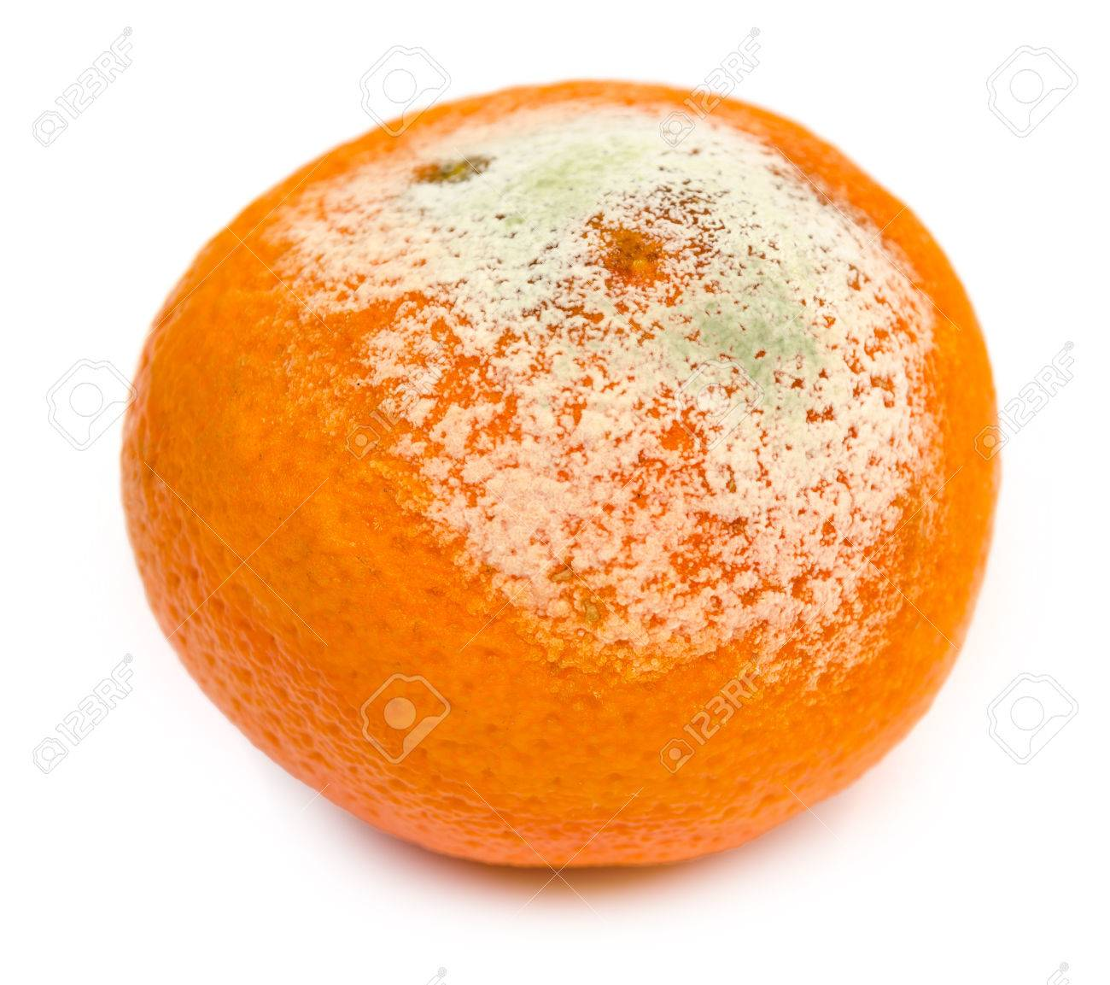
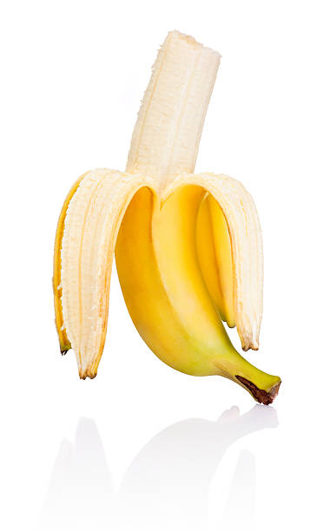
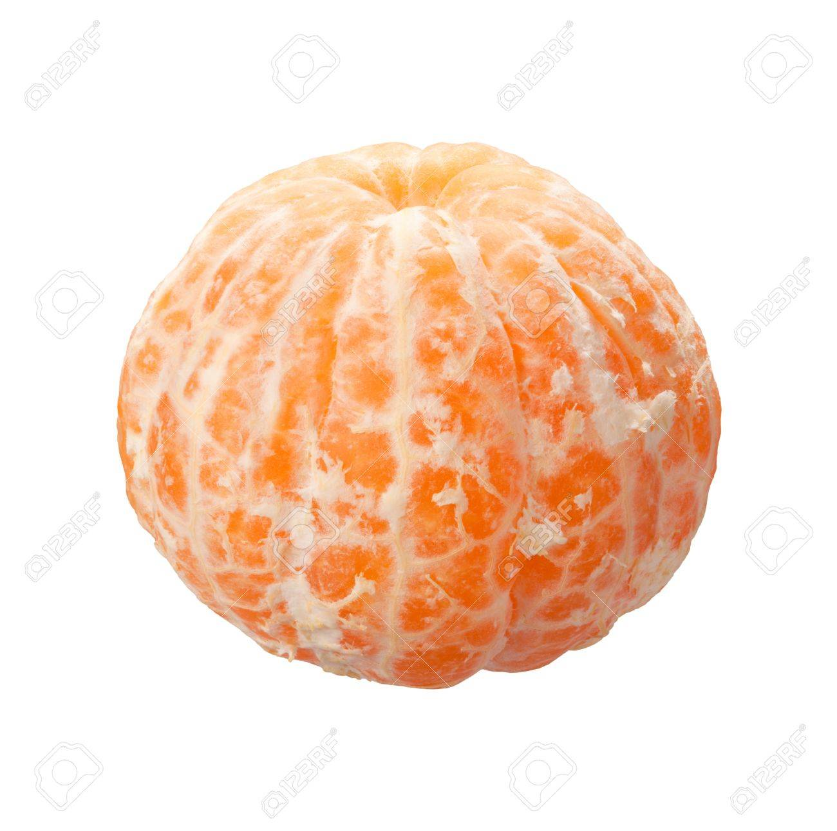
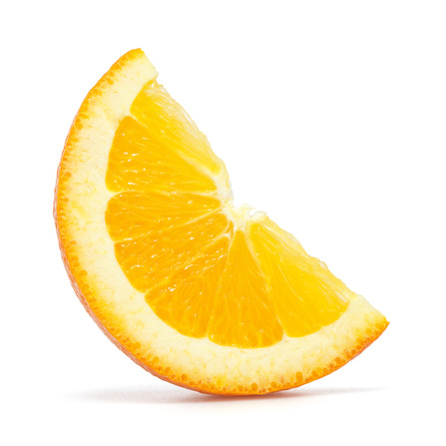
Data Collection - Too Few Images
Too Few Images Overall
We may want to recognize the fruit when it is spoiled. But spoiling patterns differ. For bananas, apples and pears they turn brown, but with orange you have a white fungus. We may want to recognize the fruit when it is partially eaten, like a bit out of an apple, a sliced orange, or a peeled banana.
Samples of fruits of different spoilage, bitten, peeled and sliced

Slide 7
Data Collection - Best Practices
Best Practices
There is a lot of things to consider, but let’s start with the basic common practices when collecting images for a dataset.
Each label (class) should have at least 1000 images.
Each distinct color for a label should be at least 10% of the images for that label.
Example: 1000 images of apples with color red, green and yellow. At least 100 should be green apples, another 100 red apples and another 100 yellow apples.
Each secondary (not always present) feature for a label should be at least 5% of the images for the label.
Example: 1000 images of apples. At least 50 are with a stem and 50 without a stem.
When there is a progression in state (e.g., age) for a label, the progression should be at least 20% of the images for the label.
Example: 1000 images of apples. At least 200 are ripe, spoiled, insect damaged, sliced or Partially eaten.

Slide 8
Data Collection - Not Any Class
Not Any Class
Another common practice that improves overall accuracy is to create one additional label as not any, and populate the label with randomly chosen images that are not of any of the labels which the model will be trained to recognize.

Slide 9
Data Collection - Unbalanced
Too Few Examples in Class (Unbalanced)
A label (class) within a dataset may simply be too small, relative to the other labels. In this case, the dataset is referred to as being unbalanced.
Here are some common practices for determining when a dataset is considered unbalanced:
If the number of images for any label is less than 20% of the mean. For example, let’s say that for each label in the fruits dataset has an average (mean) of 1000 images --then for any one label (e.g., plum), there should be at least 200 images.
If the number of images for any label is less than 10% of the label with the most images.
For example, let’s say that apples have 3000 images and has the most images of all the labels --then for any one label, there should be at least 300 images.

Slide 10
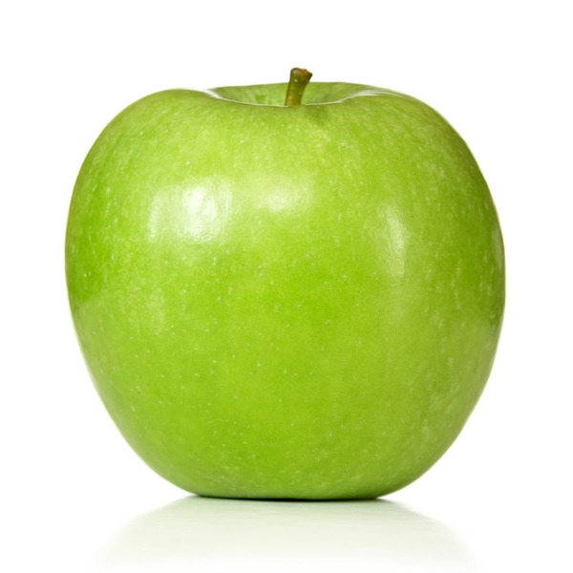
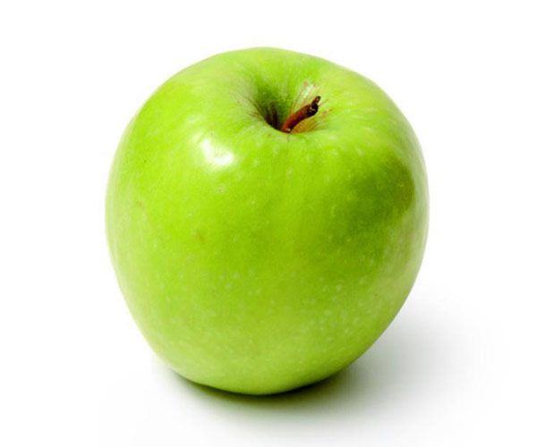
Data Collection - Insufficient Variance
Insufficient Variance in Perspective
If all the images in a label are from the same perspective (angle, distance) then it’s likely during training that the model will overfit.
Overfitting means that the weights and biases learned will be tightly fitted to the images for that label(s) in the training data, and while the accuracy will be very high with the training data, but when evaluated against image samples of a different perspective, the accuracy is very low.
A change in perspective will cause a change in spatial distances between features. Consider the example of the two images of an apple below. In the first one, the apple is viewed straight on, while in the second one, the apple is slightly tilted. It’s the same apple, but the spatial relationship between the stem and the body of the apple has changed (i.e., rotation).

Slide 11
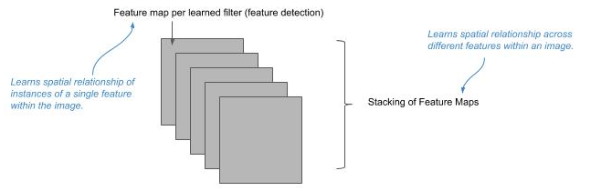
Data Collection - Spatial Relationships
Spatial Relationships of Features
Convolutional layers will learn filters to extract individual features into feature maps. Each feature map contains the strength of detection and location in the image of detecting the individual feature, from which the neural network can learn the spatial relationship and variance between instances of the single feature.
Feature maps are then stacked (see picture below). This stacking allows the neural network to learn the spatial relationships and variance between different features.

Slide 12
Data Collection - Insufficient Lighting
Insufficient Lighting
Another area to consider is the lighting conditions. Does the lighting conditions of the images reflect the variance in lighting conditions in the application that will use the trained model.
If the application is used only indoors and under a constant well lighted condition, then there may not be a need for variance in lighting conditions. For all other environments the images should have different lighting conditions, such as:
Natural Light - Daytime
Natural Light - Dusk
Indoor Light - Well Lighted
Indoor Light - Dimmed

Slide 13
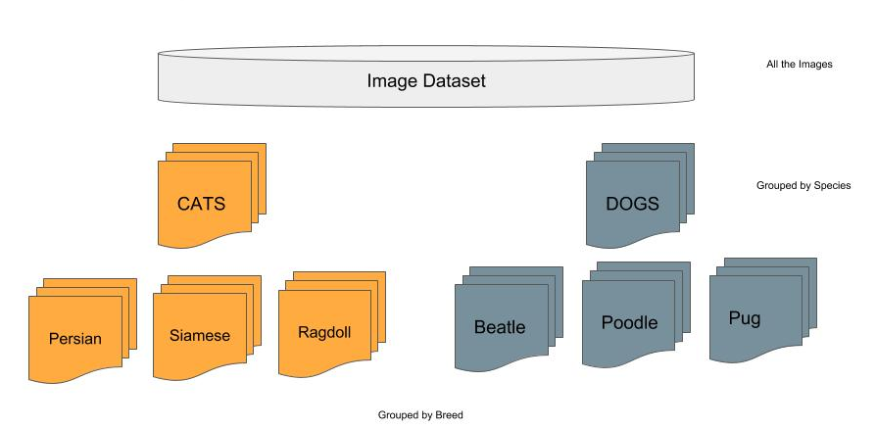
Assembling a Dataset
Assembling an Image Dataset
You need photos (images) of what your going to train a neural network to recognize (classify).
You need to decide what it is your going to classify.
You will need to group the photos by the classification you decided on.

Slide 14
Number of Images
Number of Images
Best practices recommend at least a 1000 images of each class (label).
Consider the source of the images. If they are copyrighted, you may not have the legal right to use them for training a neural network for a commercial application.
If you’re not certain on the accuracy of how correctly the images are labeled (e.g., an image of a Persian cat is labeled as a Siamese), you may want to have a second set of eyes go over and correct any mistakes. You can still learn and build a reliable neural network model with some errors if the proportion of incorrectly labeled images is very small. Typically, for statistical purposes, the rule of thumb is less than 4%.

Slide 15
Image Background Diversity
Background Diversity
Consider how the images were taken and if they are diverse enough. For example, if all the images are taken with the same background that is generally not going to be a problem. That is, if all the classes have the same background, the background will not contribute to the class recognition, and the neural network will “learn” to filter it out.
If all images of one class have the same background, and all the remaining classes have varied background, the neural network may inadvertently learn the background instead of the object for the one class. For example, in a paper published in 2016 by Rubeiro, an example dataset of wolves and huskies was used to train a model, where all the images of wolves were taken during the winter with snow in the background. The paper showed how the neural network inadvertently learned ‘snow’ for classifying a wolf, and when shown a picture of a husky in snow, it would predict the image as a wolf.

Slide 16
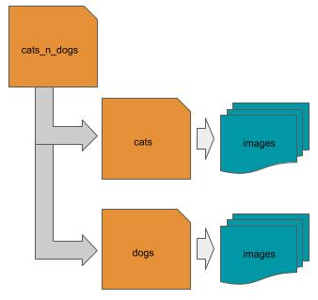
Dataset Layout - Directory Structure
Dataset as a Directory Structure
Laying out (placing) the images into a directory folder structure on a local disk is one of the most common layouts. In this layout, the root (parent) folder is a container for the dataset. Below the root level are one or more subdirectories, where each subdirectory corresponds to a class (label), and where each subdirectory contains the images that correspond to that class. Using our cats and dogs example, one would have a parent directory that might be named ‘cats_n_dogs’, with two subdirectories, one named ‘cats’ and the other ‘dogs’. Within each subdirectory would be the corresponding class of images.
.

Slide 17
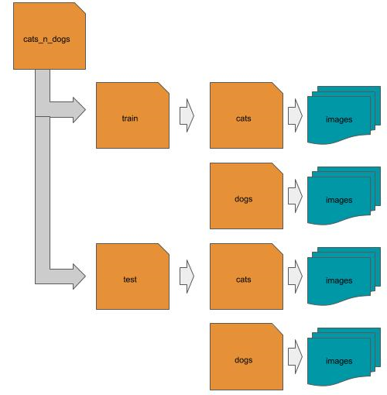
Dataset Layout - Directory Structure
Train and Test Directory Structure
Alternatively, if the dataset has been pre-split into training and test data, explained subsequently, then the split images for each class (label) are placed under the corresponding subfolders train and test, which are then underneath (subfolder of) the root folder of the dataset.

Slide 18
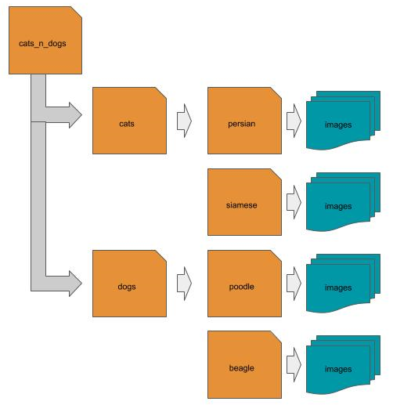
Dataset Layout - Directory Structure
Hierarchical Directory Structure
Alternatively, if the dataset has been pre-split into training and test data, explained subsequently, then the split images for each class (label) are placed under the corresponding subfolders train and test, which are then underneath (subfolder of) the root folder of the dataset.

Slide 19
Dataset Layout - CSV File
CSV File
Another common layout is to use a CSV file to identify the location and class (label) of each image. In this case, each row in the CSV file is a separate image, and the CSV file contains at least two columns, one for the location of the image, and the other for the class (label) of the image. The location might be either a local path, a remote location, or the pixel data is embedded as the value of the location.
local path example: remote path example:
label,location label, location ‘cat’, cats_n_dogs/cat/1.jpg ‘cat’,’http://mysite.com/cats_n_dogs/cat/1.jpg’ ‘dog’,cats_n_dogs/dog/2.jpg ‘dog’,’http://mysite.com/cats_n_dogs/dog/2.jpg’ … ...
embedded data example:
Label,location ‘cat’,[[...],[...],[...]] ‘dog’,[[...], [...], [...]]

Slide 20
Dataset Layout - JSON File
JSON File
Another common layout is to use a JSON file to identify the location and class (label) of each image. In this case, the JSON file is an array of objects, where each object is a separate image, and each object has at least two keys, one for the location of the image, and the other for the class (label) of the image.The location might be either a local path, a remote location, or the pixel data is embedded as the value of the location.
local path example:
[ {‘label’: ‘cat’, ‘location’: ‘cats_n_dogs/cat/1.jpg’ }, {‘label’: ‘dog’, ‘location’: ‘cats_n_dogs/dog/2.jpg’} … ]

Slide 21
Dataset Layout - HDF5 File
HDF5 File
Another common layout and storage format is to use a HDF5 (hierarchical data format) format file, which are very efficient for storing and accessing large amounts of multi-dimensional data, such as images. The format supports dataset and group objects, as well as attributes (metadata) per object. Typically, the file will consist of a group object per class (label), and each group will consist of one or more dataset objects for the corresponding images. Additional information, such as the label name, are stored as group attributes.
Group Attribute: {label: cats} Dataset: [...]
Group Attribute: {label: dogs} Dataset

Slide 22
Dataset Layout - HDF5 Hierarchical Storage
HDF5 Hierarchical Storage
The format supports hierarchical storage of groups. If the images are hierarchically labeled, then each group is further partitioned into a hierarchy of subgroups.
Group Attribute: {label: cats} Group: Attribute: {label: persian} Dataset: [...] Group: Attribute: {label: siamese} Dataset: [...]
Group Attribute: {name: dogs} Group: Attribute: {label: poodle} Dataset: [...] Group: Attribute: {label: beagle} Dataset: [...]

Slide 23
Dataset Layout - In Memory
In Memory
An image dataset may already be in memory. This is typical for curated datasets provided by ML frameworks (like Keras) for educational purposes. In this case, the image dataset has been prepared into machine learning ready data, and pre-split into train and test, with the label data already one-hot encoded (discussed later in this part).
Image 1 Image 2 Image 3 Image 4 Image 5 X_train = [ [ [...],[...],[...]], [ [...],[...],[...]], [ [...],[...],[...]], [ [...],[...],[...]], [ [...],[...],[...]], … ] Y_train = [ [... 1 …] [… 1 …], [… 1 …], [... 1 …], [... 1 …], … ]

Slide 24
Data Engineering
Data Engineering
You can’t just drop images into a neural network and expect it to learn (recognize) what the images are.
There are some preprocessing steps that need to be done with an image dataset, which is referred to as data engineering. These include:
Loading (reading) in the images as raw pixel data.
Fitting them to the input vector of the neural network which will be used for training.
Conversion of the pixel data.
Splitting the dataset
In the following sections, we will cover the different ways to perform these steps in openCV, PIL and Keras library modules.

Slide 25
Data Engineering - PIL Library
PIL Library
PIL or Pillow is Python’s image manipulation library. In this section, we use the library to manually prepare an image dataset into machine learning ready data. Let’s first cover some basics of PIL.
PIL was last updated in 2009 and supports Python 2 only. Pillow is a fork of the original PIL repo and continues to be maintained.
One can install Pillow with pip install pillow.

Slide 26
PIL Reading Images
Reading Images
The first step is to read an image from disk into memory. The image on disk will be in an image format, like JPG, PNG, TIF, etc. These formats define how the image is encoded and compressed for storage. An image is read into memory using the PIL Image.open() method.
from PIL import Image image = Image.open('myimage.jpg')

Slide 27
PIL Reading Images
Reading Images
Let’s assume you want to read in all the images under some subdirectory (e.g., cats). In the code below, we scan (get list of) all the files in the subdirectory, read each one in as an image, and maintain a list of the read-in images as a list:
Note, os.scandir() was added in Python 3.5. If you are using Python 2.7 or an earlier version of Python 3, you can obtain a compatible version with pip install scandir.
from PIL import Image import os def loadImages(subdir): images = [] # get list of all files in subdirectory cats files = os.scandir(subdir) # read each image in and append the in-memory image to a list for file in files: images.append(Image.open(file.path)) return images loadImages('cats')

Slide 28
PIL Reading Images - Subdirectories
Reading Images from Sub-Directories
Let’s expand on the above and assume the image dataset is laid out as a directory structure, where each subdirectory is a class (label). In this case, we would want to scan each subdirectory separately, and keep a record of the subdirectory names for the classes.
def loadDirectory(parent): classes = {} # list of class to label mappings dataset = [] # list of images by class # get list of all subdirectories under the parent (root) directory of the dataset for subdir in os.scandir(parent): # ignore any entry that is not a subdirectory (e.g., license file) if not subdir.is_dir(): continue # maintain mapping of class (subdirectory name) to label (index) classes[subdir.name] = len(dataset) # maintain list of images by class dataset.append(loadImages(subdir.path)) print("Processed:", subdir.name, "# Images", len(dataset[len(dataset)-1])) return dataset, classes loadDirectory('cats_n_dogs')

Slide 29
PIL Reading Images - Remote
Reading Images from Remote Locations
Let’s now try an example where the location of the image is remote (not local) and specified by an URL. In this case, we will need to make an HTTP request for the contents of the resource (image) specified by the URL and then decode the response into a binary byte stream.
from PIL import Image import requests from io import BytesIO def remoteImage(url): try: response = requests.get(url) return Image.open(BytesIO(response.content)) except: return None

Slide 30
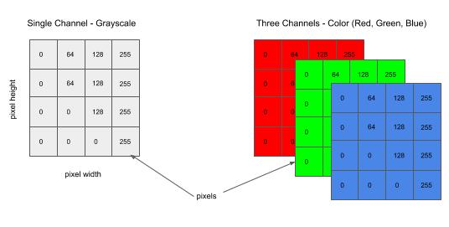
Channel Conversion
Channel Conversions (Grayscale vs. Color)
Next, we need to set the number of channels to match the input shape of your neural network. The number of channels is the number of color planes in your image. For example, a grayscale image will have one color plane. An RGB color image will have three color planes, one for each of Red, Green and Blue.

Slide 31
PIL Channel Conversion
Image.open() and Alpha Channels (RGBA)
The Image.open() method will read in the image according to the number of planes in the image stored on disk. So if its a grayscale image, it will read it in as a single plane, if it’s RGB it will read it in as three planes, and if it’s RGBA (+alpha channel), it will read it in as 4 planes.
In general when working with RGBA images, the alpha channel can be dropped. It is a mask for setting the transparency of each pixel in the image, and therefore does not contain information that would otherwise contribute to the recognition of the image.

Slide 32
PIL Channel Conversion
Convert Number of Channels to Match Input Shape
Once the image is read into memory, the next step is to convert the image to the number of channels that match the input shape of your neural network.
The convert() method will do channel conversion. A parameter value of ‘L’ will convert to single channel (grayscale) and ‘RGB’ to three channel (RGB color). Below we updated the loadImages() function to include channel conversion:
def loadImages(subdir, channels): images = [] # get list of all files in subdirectory cats files = os.scandir(subdir) # read each image in and append the in-memory image to a list for file in files: image = Image.open(file.path) # convert to grayscale if channels == 1: image = image.convert('L') # convert to RGB color else: image = image.convert('RGB') images.append(image) return images loadImages('cats', 3)

Slide 33
PIL Resizing
Resizing
Next, we need to resize each image to fit the shape of the input shape of the neural network. For example, a 2D convolutional neural network will take a shape of the form (height, width, channels). We dealt with the channel portion above, so next we need to resize the pixel height and width of each image to match the input shape. For example, if the input shape is (64, 128, 3), then we want to resize the height and width of each image to (64, 128). The resize() method will do the resizing.
In most cases, you will be downsizing (i.e., downsampling) each image. For example, 1024 x 768 image will be 3Mb in size. This is far more resolution than a neural network needs (see section on Convolutional Neural Networks). When the image is downsized, some resolution (details) will be lost. To minimize the effect when downsizing, it is a common practice to use the anti-aliasing algorithm in PIL.
def loadImages(subdir, channels, shape): # … deleted for brevity for file in files: image = Image.open(file.path) # … deleted for brevity # resize the image to the target input shape images.append(image.resize(shape, Image.ANTIALIAS)) return images loadImages('cats', 3, (128, 128))

Slide 34
PIL to Numpy Array
Converting PIL objects to Numpy Arrays
In Keras (and other Python ML frameworks), the inputs to neural networks are multi-dimensional numpy arrays. Lists in Python are implemented as dynamic arrays and use indirect addressing on the heap. While this provides great flexibility, the performance is very poor for large dynamic arrays. In machine learning, arrays (vectors, matrices, tensors and batches) are very, very large.
The numpy module is a package that implements high-performance large array handling in contiguous memory in C, with a Python linkage.
For our purposes, we are going to want to convert the list of PIL images to a multi-dimensional numpy array. We can do this with the numpy.asarray() method.

Slide 35
PIL to Numpy Array
Converting PIL objects to Numpy Arrays
In the code example below, we update the loadImages() function to include the step of converting the list of PIL images to a numpy array.
def loadImages(subdir, channels, shape): images = [] # … deleted for brevity # UPDATED STEP # convert all the PIL images to numpy arrays in a single invocation return np.asarray(images) loadImages('cats', 3, (128, 128))

Slide 36
OpenCV Library
OpenCV Library
OpenCV is an open source image manipulation library that is implemented in a wide variety of programming languages, including Python. It has been around a long-time and widely supported and updated by the open source community. It has been the conventional work-horse of imaging scientists.
Everything we did in PIL, we will show in this section how to do in OpenCV.
One can install OpenCV with pip install opencv-python.

Slide 37
OpenCV Reading Images
OpenCV Reading Images
An image is read into memory using the cv2.imread() method. One of the first advantages I find with the cv2.imread() method is the output is already in a multi-dimensional numpy data type.
By default, cv2.imread() will convert the image to a three channel RGB image.
import cv2 image = cv2.imread('myimage.jpg')

Slide 38
OpenCV Channel Conversion
OpenCV Channel Conversion
Another advantage of OpenCV over PIL is that you can do the channel conversion at the time of reading in the image, instead of a second step. You can specify a second parameter that indicates which channel conversion to use. In the example below, we show doing the channel conversion at the time the image is read in.
# read in image as a single channel (grayscale) image if channel == 1: image = cv2.imread('myimage.jpg', cv2.IMREAD_GRAYSCALE) # read in image as a three channel (color) image else: image = cv2.imread('myimage.jpg', cv2.IMREAD_COLOR)

Slide 39
OpenCV Reading Image - Remote
OpenCV Reading Image from Remote Location
In the example below, we show reading in the image from a remote location (url) and doing the channel conversion at the same time. In this case, we use the method cv2.imdecode():
try: response = requests.get(url) if channel == 1: return cv2.imdecode(BytesIO(response.content), cv2.IMREAD_GRAYSCALE) else: return cv2.imdecode(BytesIO(response.content), cv2.IMREAD_COLOR) except: return None

Slide 40
OpenCV Resizing Image
OpenCV Resizing
Images are resized using the cv2.resize() method. The second parameter is a tuple of the height and width to resize the image to. The optional (keyword) third parameter is the interpolation algorithm to use when resizing. Since in most cases you will be downsampling, the common practice is to use the cv2.INTER_AREA algorithm for best results in preserving information and minimizing artifacts when downsampling an image.):
# resize an image to 128 (height) x 128 (width) image = cv2.resize(image, (128, 128), interpolation=cv2.INTER_AREA)

Slide 41
OpenCV LoadImages()
Rewrite LoadImages() using OpenCV
Let’s now rewrite the loadImages() function using OpenCV.
def loadImages(subdir, channels, shape): images = [] # get list of all files in subdirectory cats files = os.scandir(subdir) # read each image in and append the in-memory image to a list for file in files: # convert to grayscale if channels == 1: image = cv2.imread(file.path, cv2.IMREAD_GRAYSCALE) # convert to RGB color else: image = cv2.imread(file.path, cv2.IMREAD_COLOR) # resize the image to the target input shape images.append(cv2.resize(image, shape, cv2.INTER_AREA)) return np.asarray(images) loadImages('cats', 3, (128, 128))

Slide 42
Normalization (Standardization)
Normalization and Data Type
At this point, all the image data is in a numpy multidimensional array. As a final step, we want to perform :
normalization (or standardization) on the pixel data, and
fit the pixel data to a data type size.
The process makes all the images have a similar pixel value distribution, which leads to faster convergence when training a neural network. This means less epochs (or steps), which means less total compute time.
Normalization will squash all the pixel values in a range between 0 and 1, or between -1 and 1, while standardization will squash the pixel values into a distribution with a mean centered at 0 and one standard deviation.

Slide 43
Normalization
Normalization using Numpy
Images taken by a camera are almost universally 8 bits per pixel per channel format, represented as an unsigned 8 bit integer value (e.g., np.uint8). Therefore, we can do the squashing function by dividing each pixel value by 255. So a value 0 would become a 0, a value of 255 would become a 1, and all other values will be in-between.
The numpy library has overridden the division operator between two numpy arrays to perform a very fast array-wide matrix division. So we can do this operation as a single step.
# Normalization between 0 and 1 of 8 bits per pixel per channel images = images / 255.0

Slide 44
Normalization - High Dynamic Range
Normalization of High Dynamic Range Images (16bpp/channel)
In some image datasets, the images may be in a different bits per pixel representation. For example, 16 bits per pixel per channel for high color images, which have a dynamic color range between 0 .. 65535 vs 0 .. 255 for 8 bits per pixel. When normalizing between 0 and 1, we need to divide by the maximum value of the pixel range.
if images.itemsize == 1: images = images / 255.0 # Normalization between 0 and 1 of 16 bits per pixel per channel elif images.itemsize == 2: images = images / 65535.0

Slide 45
Normalization - Center at Zero
Normalization between 0 and 1
When normalizing, some prefer to normalize between -1 and 1, to center the pixel values around 0.
if images.itemsize == 1: images = images / 127.5 - 1 elif images.itemsize == 2: images = images / 32767.5 - 1

Slide 46
Standardization
Standardization
Another method of squashing pixel values into a similar distribution is called standardization. In this method, a mean and a standard deviation are calculated across all the pixel values. Then the mean is centered at zero and each pixel divided by a standard deviation of 1. This takes more computation than normalization.
If your images are a fairly basic and fairly consistent distribution of pixel values, then a normalization is sufficient. For example, in the MNIST dataset, all the digits are in a narrow grayscale range and all the backgrounds are the same. For this case, normalization is sufficient. When your working though with color images, the distribution of pixel values can be very diverse across images. In general, normalization is used with grayscale images and standardization with color images.

Slide 47
Standardization
Standardization
To prevent a division by zero in the case where the standard deviation is zero, it is a common practice to add a tiny amount, referred to as an epsilon, so the denominator will never be zero.
# standardization across all pixels/channels e = 1e-7 # epison, add a tiny amount to standard deviation to prevent divide by 0. images = (images - np.mean(images)) / (np.std(images) + e)

Slide 48
Standardization - Other Means
Standardization - Per Channel and Per Pixel (Image) Mean
The previous example calculated the mean and standard deviation across all pixels and channels. Other practices will calculate a mean and standard deviation per channel. In the case of a 3 channel RGB image, this is done as:
Another practice is to calculate the mean and standard deviation on a per pixel location. In the case of a 3 channel RGB image, this is done as:
# standardization by per channel mean e = 1e-7 # epison, add a tiny amount to standard deviation to prevent divide by 0. images = (images - np.mean(images, axis=(0,1))) / (np.std(images, axis=(0,1)) + e)
# standardization by mean image e = 1e-7 # epison, add a tiny amount to standard deviation to prevent divide by 0. images = (images - np.mean(images, axis=(2))) / (np.std(images, axis=(2)) + e)

Slide 49
Data Types
Floating Point Size
The last step is setting the data type of the normalized (or standardized) pixel data. At this point the pixel data values are floating point numbers, and generally very small numbers (e.g., between 0.0 and 1.0). By default, numpy will represent floating point values as double precision floats (float64). That’s 8 bytes per float, which is 8 bytes per pixel per channel. Let’s assume the input shape to the neural network is (128, 128, 3). That will require 50K pixels per image, and at 8 bytes per pixel per channel, that’s 400K bytes per image. At 10,000 images, that will require 4GB of memory to hold them all at once in memory.
Neural networks work well with lower float precision. Single precision float (float32) is the common practice, which takes ½ the space and ¼ the number of floating point instructions per cycle.
# set the data type images = images.astype(np.float32) # now do the standardization e = 1e-7 # epison, add a tiny amount to standard deviation to prevent divide by 0. images = (images - np.mean(images)) / (np.std(images) + e)

Slide 50
Keras Image Preprocessing
Keras Image Preprocessing
Keras provides image preprocessing functions for both in-memory (i.e., numpy arrays) and on-disk images with the class ImageDataGenerator. This class combines data preprocessing, data feeding and data augmentation in a single step. I find whether you do your data preprocessing, as well as augmentation and feeding, outside of Keras functions or all-in-one is a personal preference.
For those wanting the fine level control of the data for functionality and the bare-metal programming for speed, I recommend the ‘manual’ approach of using openCV or PIL.
For those seeking an easy encapsulation of the steps, I would recommend the methods builtin to Keras.

Slide 51
ImageDataGenerator
Data Feeder - ImageDataGenerator
The ImageDataGenerator class creates a generator for feeding batches into a neural network during training. For our purpose here, I will only cover the preprocessing functions. The subset of parameters in ImageDataGenerator for preprocessing are:
rescale / dtype
featurewise_center / featurewise_std_normalization
samplewise_center / samplewise_std_normalization
zca_whitening / zca_epsilon
The image preprocessing using ImageDataGenerator is a two-step process:
Specify normalization / standardization in the instantiation of the ImageDataGenerator object.
The images are presumed to either:
be in memory as numpy tensors and already resized (flow() method), or
are resized when feeding from disk using the flow_from_directory() method.

Slide 52
ImageDataGenerator - Normalization
Normalization with ImageDataGenerator
In this code example, we instantiate the ImageDataGenerator to do a normalization of the pixel data by squashing the values between 0 and 1, and then perform the normalization by invoking the fit() method of the training data (x_train).
from keras.preprocessing.image import ImageDataGenerator # specify normalizing the pixel data between 0 and 1 (for 8 bits per pixel/per channel) datagen = ImageDataGenerator(rescale=1/255.0) # normalize the pixels pixels in the training data datagen.fit(x_train)

Slide 53
ImageDataGenerator - Normalization
Standardization with ImageDataGenerator
Alternately, we can normalize the pixel data by centering it around the mean (i.e., per channel mean) by setting the featurewise_center to True.
Additionally, we can specify to do standardization of both centering the pixel data around the mean (i.e., per channel) and squashing the values to +/- one standard deviation by setting featurewise_std_normalization to True.
# specify normalizing the pixel data by centering them around a mean of 0 datagen = ImageDataGenerator(featurewise_center=True)
# specify normalizing the pixel data by centering them around a mean of 0 and # squashing the values within +/- one standard deviation datagen = ImageDataGenerator(featurewise_std_normalization=True)

Slide 54
ImageDataGenerator - Data Type
Setting Data Type with ImageDataGenerator
The data type of the pixel data, after optional normalization or standardization, by default with be a double precision float (FLOAT64). The parameter dtype when specified, will cast the pixel data to the corresponding data type, which is specified as a numpy data type (e.g., np.float32 for FLOAT32).
# specify normalizing the pixel data by centering them around a mean of 0 and # squashing the values within +/- one standard deviation datagen = ImageDataGenerator(featurewise_std_normalization=True, dtype=np.float32)

Slide 55
flow_from_directory() - Resizing
flow_from_directory() Method - Resizing
When feeding data during training to a Keras model, the data is either feed from in-memory or on-disk. When feeding in-memory using the flow() method, you must resize the images prior to feeding the neural network, such as the methods we described using PIL or OpenCV.
When you feed from on-disk using the flow_from_directory(), your set the parameter target_size to the height x width (HxW) of the input vector to the neural network.
# Create generator for feeding neural network from on-disk, and resize images to 128 x 128 as being feed feeder = datagen.flow_from_directory('root_of_dataset', target_size=(128, 128)) # Train the neural network by calling the fit_generator() method with the above feeder model.fit_generator(feeder, steps_per_epoch=steps, epochs=epochs)

Slide 56
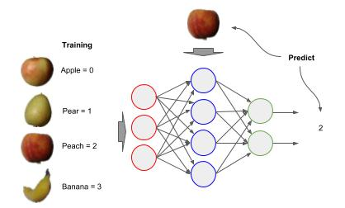
Label Encoding
Label Encoding
We need to keep track of which label (class) goes with each image. For each class (e.g., apple, pear, peach, banana, etc - Fruits360) we assign a unique integer value, starting with 0 to represent the class (remember everything in a neural network is a number - even the labels). When we train a neural network, the label will be the integer value we assigned to the class (y) and when predicting the neural network will output the integer value of the class it predicts (ŷ , aka. y-hat).

Slide 57
Label Encoding
Build a List of Labels corresponding to the Images
In the previous loadDirectory() example, the list dataset has an entry for each class of images processed, and the length of the entry is the number of images. In the code below we build a parallel list for the corresponding labels, with the same number of entries, and same length per entry as the dataset (processed images).
In the above, we set the data type of the labels to np.uint16, which is a 16-bit integer which can hold up to 65,535, to conserve space. If you have more than 65,535 classes, then you will want to set the data type as np.uint32.
dataset, classes = loadDirectory('fruits') # construct a corresponding labels list for ix, images in enumerate(dataset): # The labels have the same indices as the images (that's the label) label = np.asarray([ix] * len(images)).astype(np.uint16) labels.append(label)

Slide 58
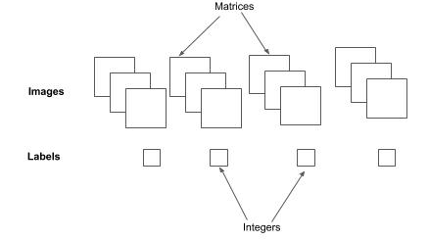
Label Encoding
Labels and Images as Multi-Dimensional Numpy Arrays
Next, we want both the list of processed images (machine learning ready data) and list of labels to each be a single long contiguous array. We use the np.concatenate() method to concatenate each element sequentially in a list into a single contiguous multidimensional numpy array.
# Convert list of Images and Labels to a contiguous numpy multidimensional array dataset = np.concatenate(dataset) labels = np.concatenate(labels)

Slide 59
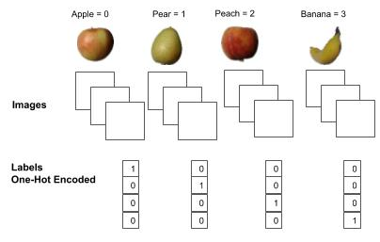
One Hot Encoding of Labels
One Hot Encoding of Labels
The final preparation step for the labels is to one-hot encode them to match the output vector of the neural network. The neural network will have an output node per class. For each label (e.g., 2), a one value is placed at the index location in the output vector that corresponds to the node for that label, and the remaining entries have the value 0.

Slide 60
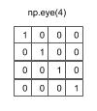
One-Hot Encoding using Numpy
One Hot Encoding of Labels using Numpy
The code example below demonstrates how to ‘manually’ do a one hot encoding in a single shot. The function one_hot() takes as input the 1D array of labels (Y) and outputs a 2D one-hot encoded version (return Y). The second parameter (C) is the number of classes (output nodes), which will correspond to the length of each one-hot encoded label. The np.eye() method creates a zero value 2D matrix with an equal number of rows and columns (square) specified by the parameter C, and then places a one value along the diagonal.
def one_hot(Y, C): """ Convert Vector to one-hot encoding """ Y = np.eye(C)[Y.reshape(-1)] return Y # one-hot encode the labels labels = one_hot(labels, len(classes))

Slide 61
One-Hot Encoding in Keras
One Hot Encoding of Labels in Keras
The Keras framework has a builtin method to_categorical() to automatically do one-hot encoding of labels.
from keras.utils import to_categorical # one-hot encode the labels labels = to_categorical(labels, len(classes))

Slide 62
Dataset Splitting
Splitting into Train and Test
When training a neural network for computer vision, one splits the processed image dataset into training data and test data, also referred to as the holdout set. That is, a portion of the processed image dataset is set aside to test the accuracy of the trained model, and is not used as part of the training. Generally only a small percentage should be set aside, and the larger the image dataset, the smaller that percentage can be. Below is a general rule of thumb of the percentage to set aside for test data, based on the number of images in the dataset:
< 1000 20% <10000 10%
>10000 5%

Slide 63
Dataset Shuffling
Shuffle and then Split
Prior to splitting the image dataset, we will want to randomly shuffle it. Why? Let’s presume that when building the dataset that all the images were sequenced by class. For example, all the apples come first, followed by pears, followed by peaches, and then by bananas. If we split this as 75% train and 25% test without shuffling, all the apples, pears and peaches will be in the training set and the bananas in the test set. The model won’t learn to recognize bananas, since they are not in the training set, and the test set will attempt to test for a class that the model hasn’t been trained on.

Slide 64
Dataset Shuffling
Shuffle and then Split
If we randomly shuffle the processed image dataset, we can assume a fairly balanced distribution of the classes between the training and test data. The example code below shows a ‘manual’ method to shuffle the processed image dataset prior to splitting.
Random number generators are actually pseudo random number generators, in that they use a mathematical formula to generate a pseudo random number sequence. A seed initializes the formula; whereby the same seed will always generate the same random number sequence. To shuffle both the dataset (images) and labels separately and maintain the same corresponding random sequence between the two, we use the same seed before each shuffle.
import random # set a seed for the random number distribution before shuffling the data (images) random.seed(101) random.shuffle(dataset) # set the same seed before shuffling the corresponding labels to get the same random number distribution random.seed(101) random.shuffle(labels)

Slide 65
Dataset Slicing
Manual Split using Python Slicing
In the code below, we calculate a pivot point in the shuffled dataset, where the training percentage will be before the pivot point and the test percentage after the pivot point. We then use the pivot point to create (array slicing) the corresponding train and test dataset and labels.
# Split the preprocessed image data (and labels) into train and test data pivot = int(len(indices) * (1 - SPLIT)) X_train = X[:pivot] Y_train = Y[:pivot] X_test = X[pivot:] Y_test = Y[pivot:]

Slide 66
Dataset Splitting - Scikit-Learn
Dataset Splitting with Scikit-Learn
One can automatically shuffle and split a processed image dataset and labels using the scikit-learn function train_test_split().
from sklearn.model_selection import train_test_split # Split the processed image dataset into training and test data X_train, X_test, Y_train, Y_test = train_test_split(dataset, labels, test_size=0.20, shuffle=True)

Slide 67
Dataset Splitting - Keras
Dataset Splitting with Keras
As an alternative if the dataset is to be fed from on-disk (vs. in-memory), one can automatically shuffle and split the dataset and labels using Kera’s ImageDataGenerator method flow_from_directory().
# Create data generator where images will be normalized between 0 and 1, and # split the dataset between training and validation (10%). datagen = ImageDataGenerator(rescale=1/255.0, validation_split=0.1) # Create a generator to feed the model during training generator = datagen.flow_from_directory(dataset_directory, target_size=(128, 128), batch_size=32, shuffle=True) # train the model model.fit_generator(generator, epochs=50)

Slide 68
Data Engineering - Code Lab #1
Optional Code Lab - Get Familiar with Data Preprocessing
Idiomatic Programmer - handbook 2 - Codelab 1.ipynb

